Slide 1

RESTAURANT RECOMMENDATION SYSTEM
Nguyễn Thị Trường An – ITDSIU18002
Nguyễn Ngọc Khánh – ITDSIU18025
Lê Triệu Long – ITDSIU19044

Slide 2
3 functions:
Location-Based Recommendation
Collaborative-Filtering Recommendation
Content-Based Recommendation

Slide 3
Overview
Explanatory Data Analysis
Natural Language Processing
Recommendation System
Location-Based
Collaborative-Filtering
Content-Based
Pandas
Seaborn
Plotly
Sentiment Analysis
Topic Modeling

Slide 4

Yelp Portland Dataset
The Yelp dataset is a subset of Yelp's businesses, reviews, and user data that has been made publicly available for use for personal, educational, and academic purposes.

Slide 5
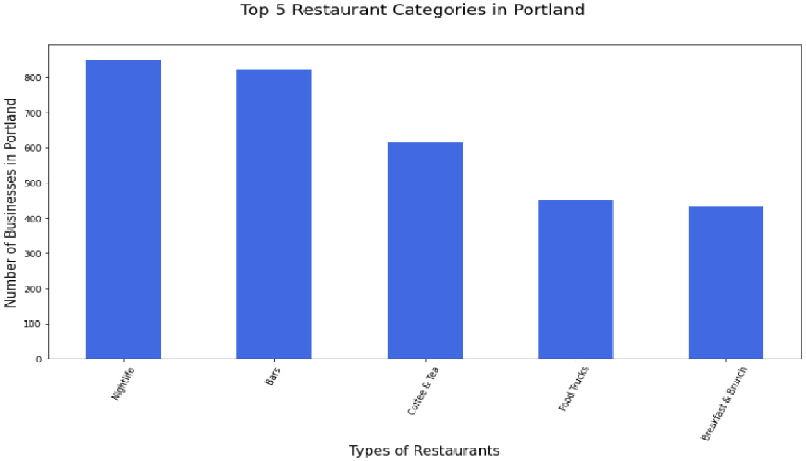
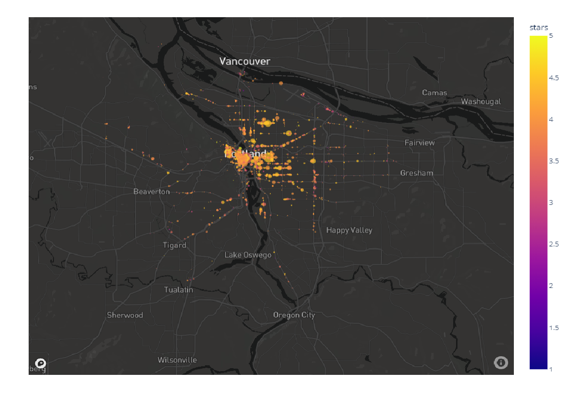
EDA on Restaurant Data
Top 5 Most Popular Restaurant Categories:
Nightlife (850 Restaurants)
Bars (821 Restaurants)
Coffee & Tea (615 Restaurants)
Fast Food (450 Restaurants)
Breakfast & Brunch (433 Restaurants)

Slide 6
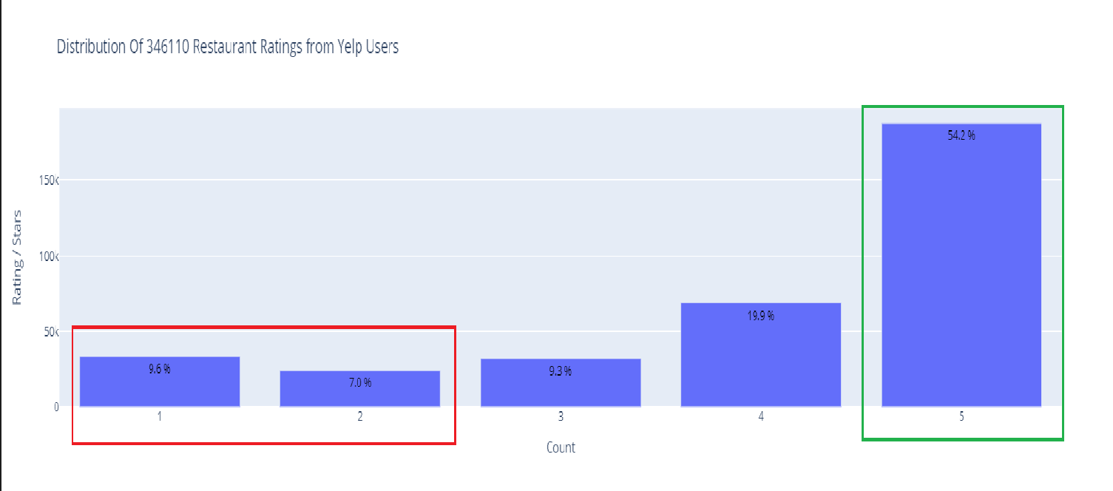
EDA on Reviews Data
187,660 Positive Reviews
Screen Door
Most # of Positive Reviews (7,219)
57,444 Negative Reviews
Voodoo Doughnut - Own Town
Most # of Negative Reviews (9,185)

Slide 7
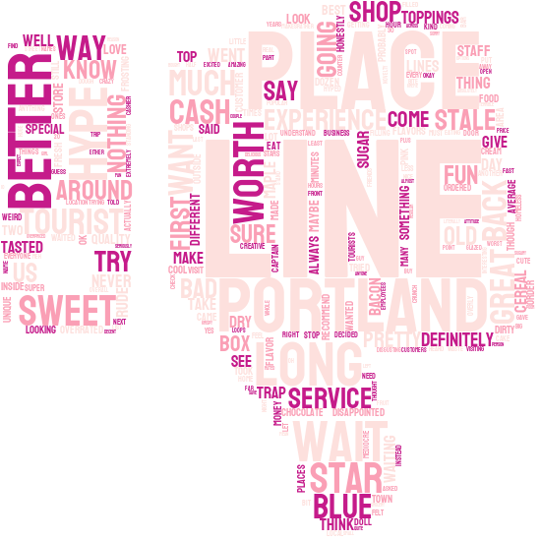
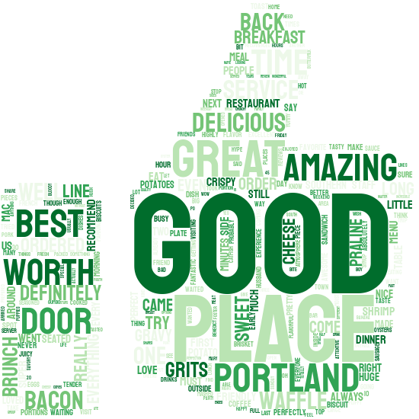
EDA on Reviews Data
Negative Reviews
Positive Reviews

Slide 8




Sentiment Analysis
=
Compound Score [-1, 1]
Yelp Rating (1-5)
Polarity Score [-1, 1]
Super Score (0-6)
Sentiment Analysis on Text Reviews
Polarity Score: positive statement = 1, negative statement = -1
Compound score: most positive = 1, most negative = -1

Slide 9
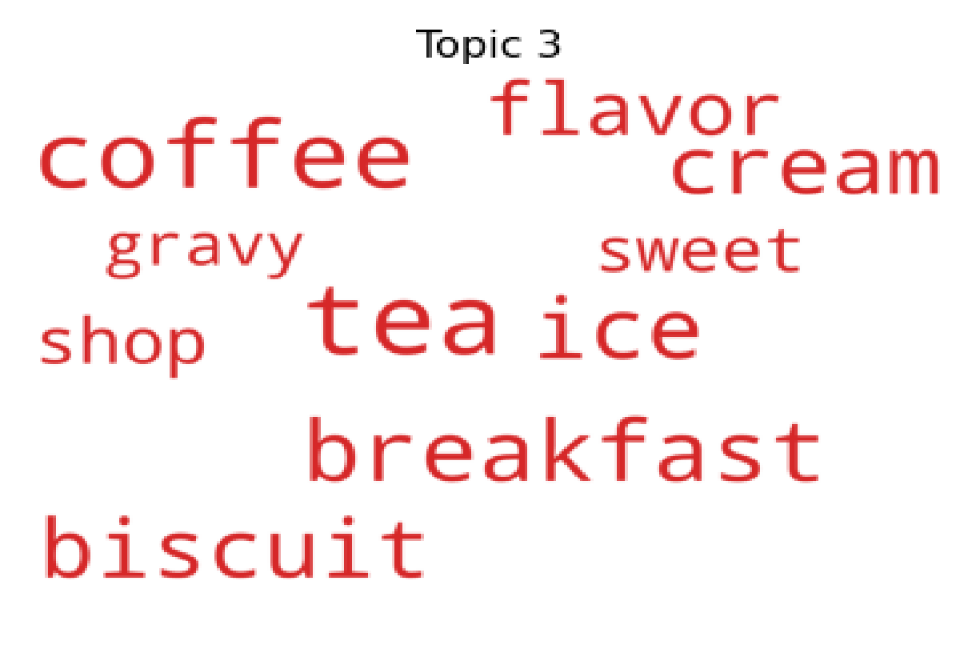
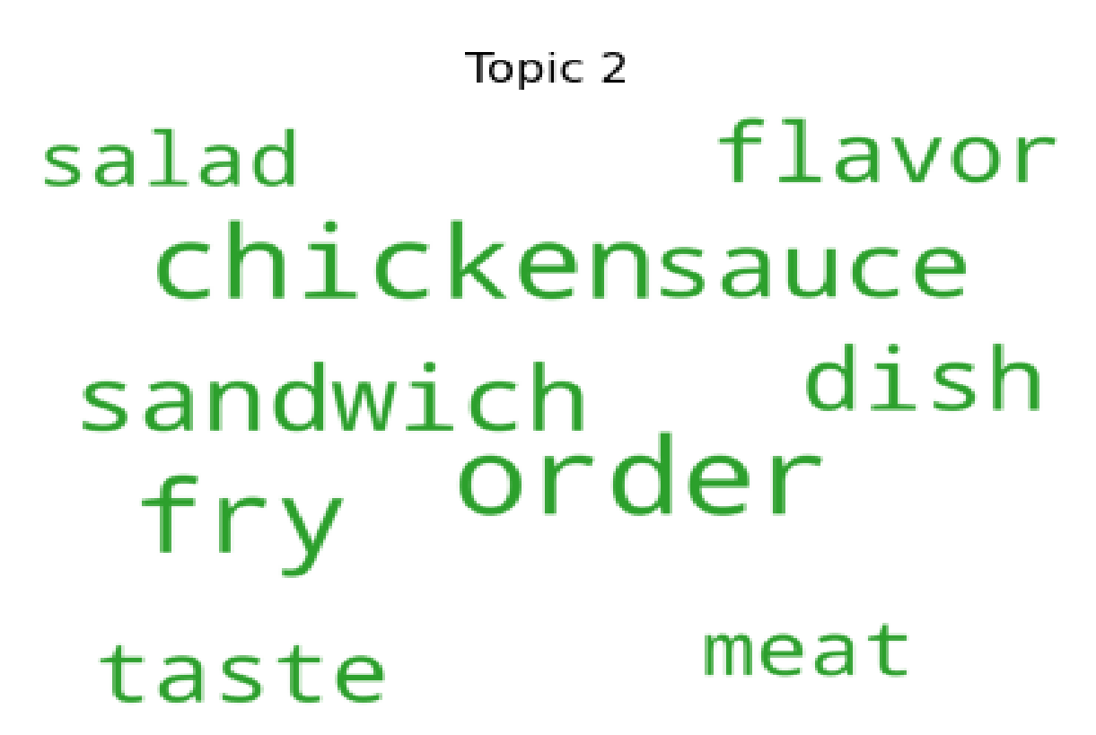
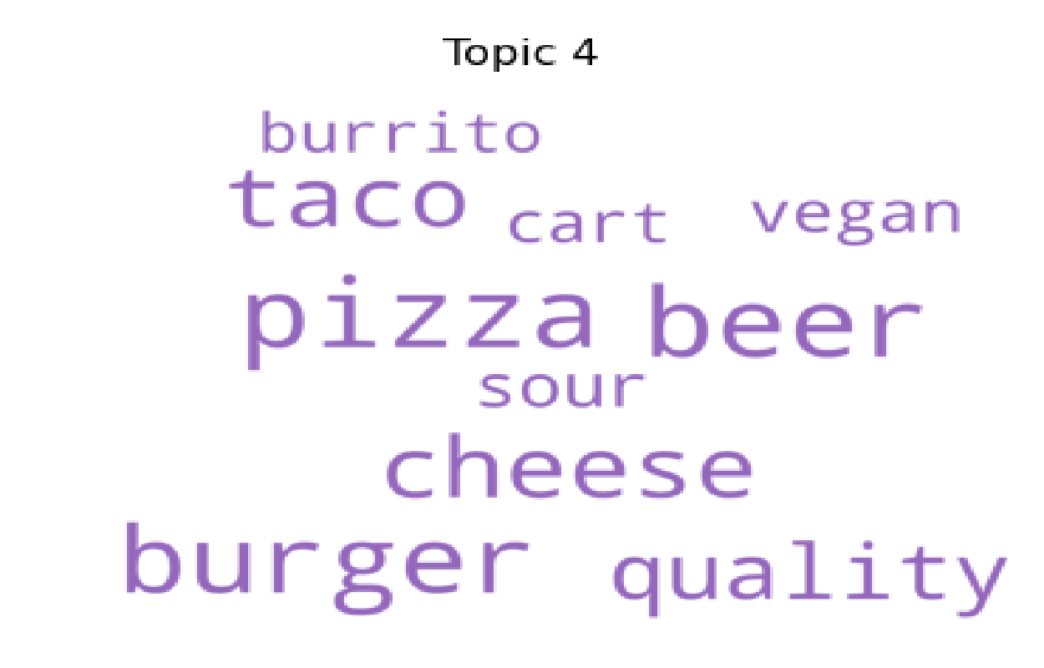
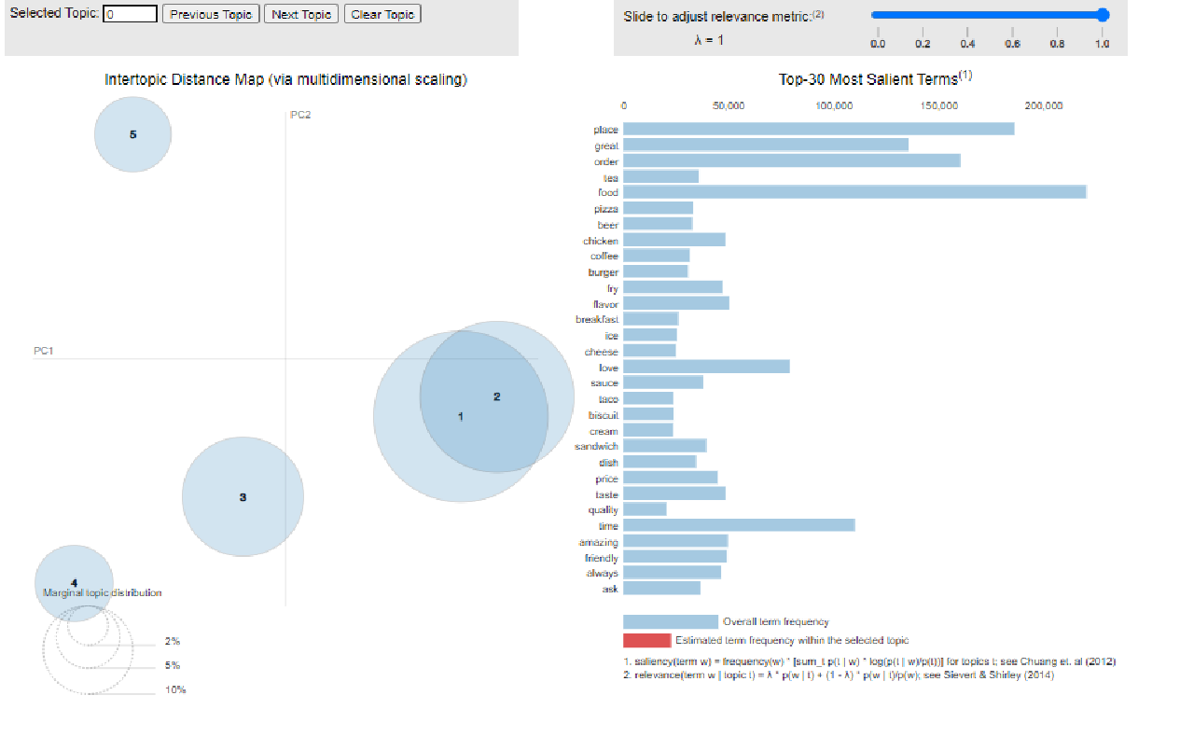
Topic Modeling
Western (Topic 2)
Dessert (Topic 3)
Fast food (Topic 4)

Slide 10
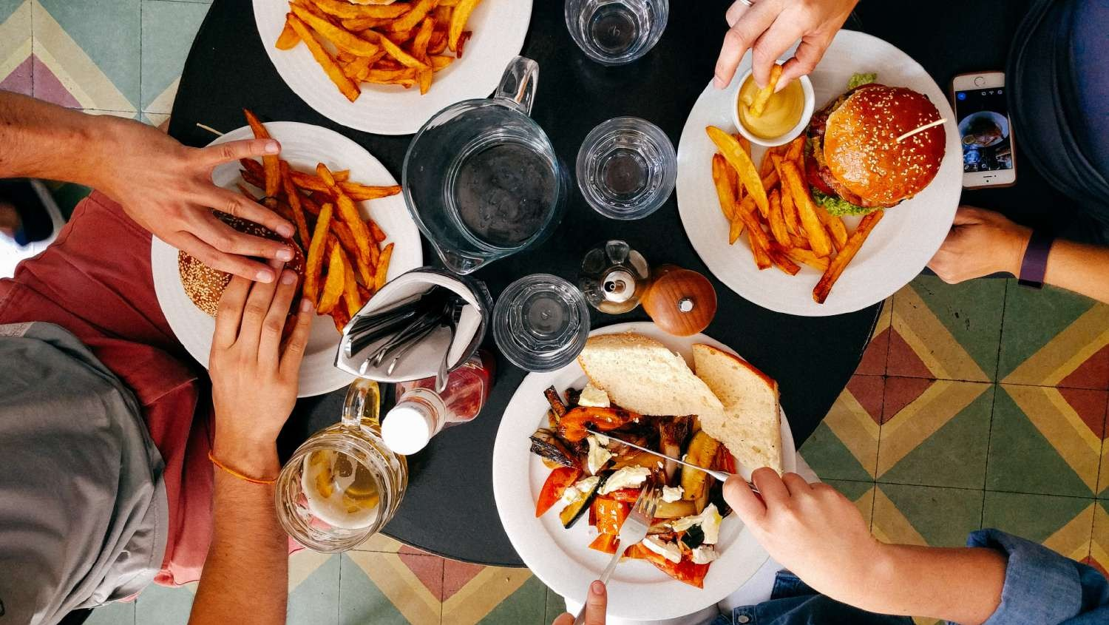
Building Our Recommendation Functions

Slide 11

Cold-Start Problem
It is difficult to provide personalized recommendations to new users without any information about their prior preferences. We have to use a naïve solution to solve the cold-start problem.
Review Feedback
1
Retrain Model
2
3
Sort Ratings
4
New Recommendation

Slide 12

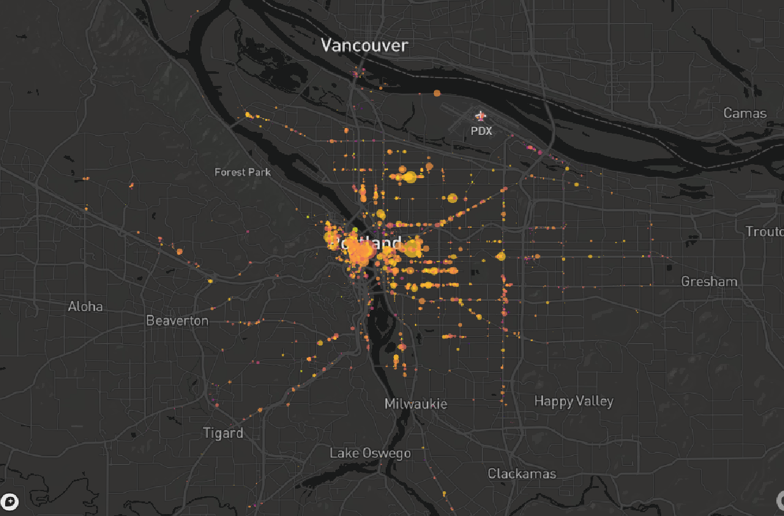
Location-Based Recommendation

Slide 13
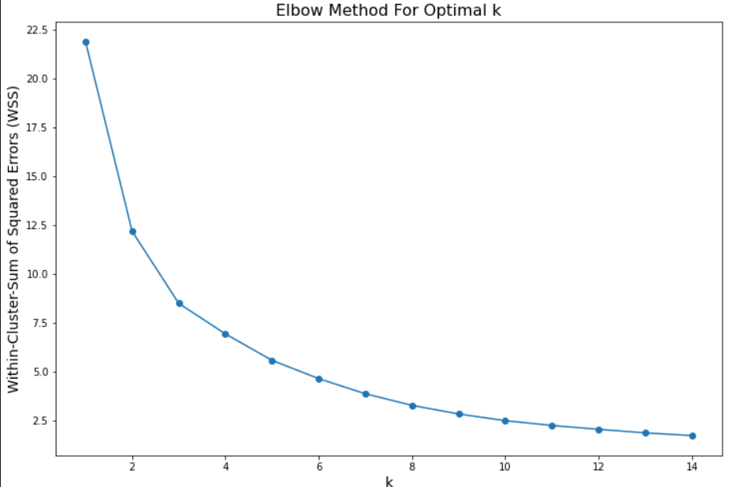
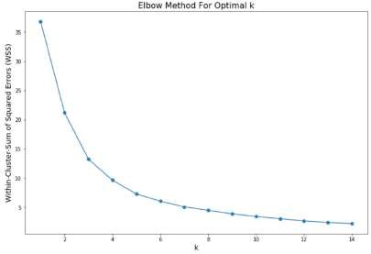
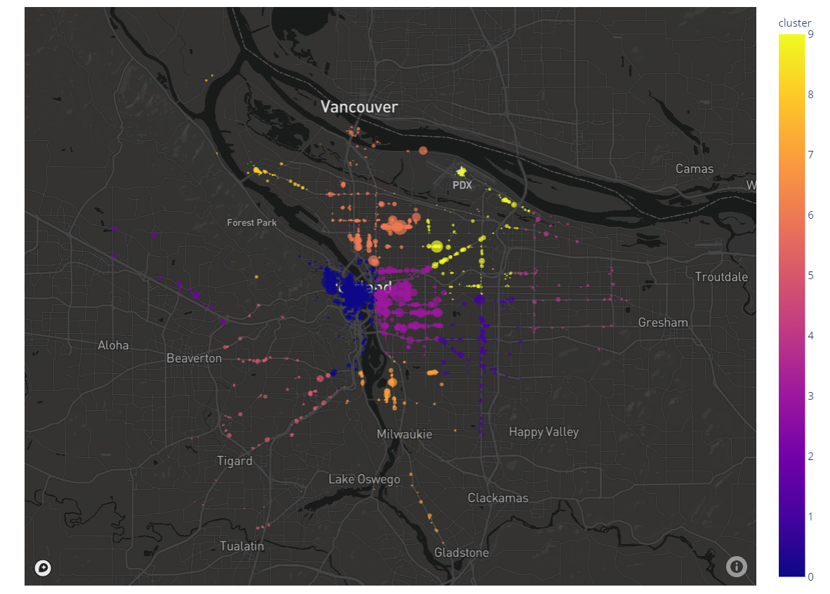
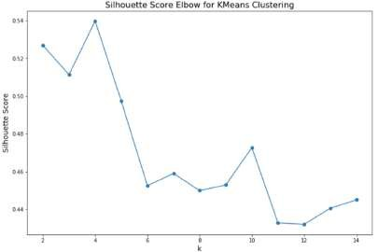
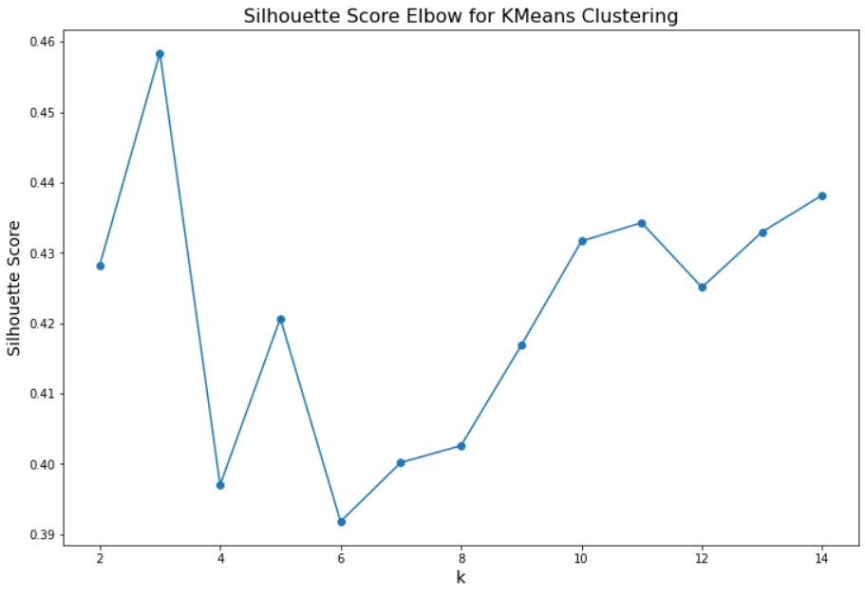
Location-Based Recommendation
Group Restaurants together based on geographical proximity using K-Means Clustering.

Slide 14

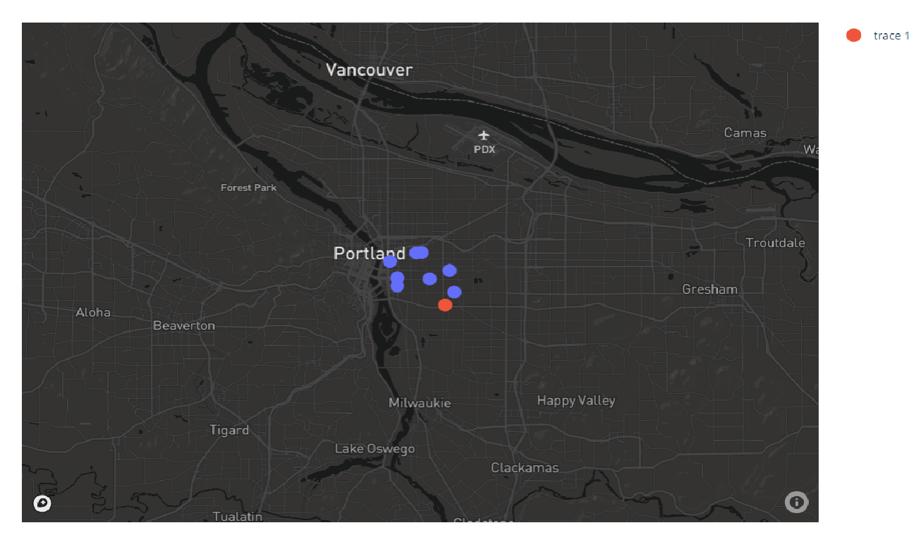
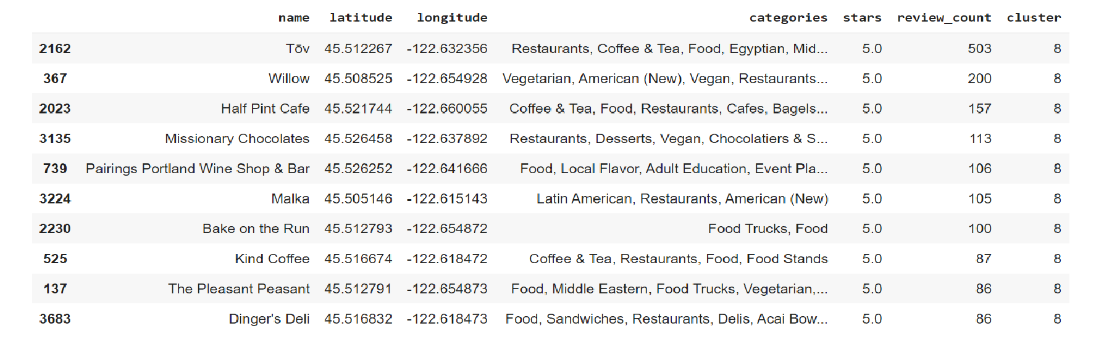
Location-Based Recommendation
Case Study: Studio One Theaters
In our example, let's assume that a user has just visited the Studio One Theaters in Portland. After watching a movie, they want to have a meal but is unsure of what nice restaurants are around them.

Slide 15


Collaborative-Filtering Recommendation
Collaborative Filtering finds a smaller set of users with tastes similar to a particular user.
It looks at the restaurants they like and combines them to create a ranked list of suggestions.
Steps:
Pivot Table on Super Score Ratings
Truncated Singular Value Decomposition
Item-Item Matrix based on Cosine Similarity

Slide 16

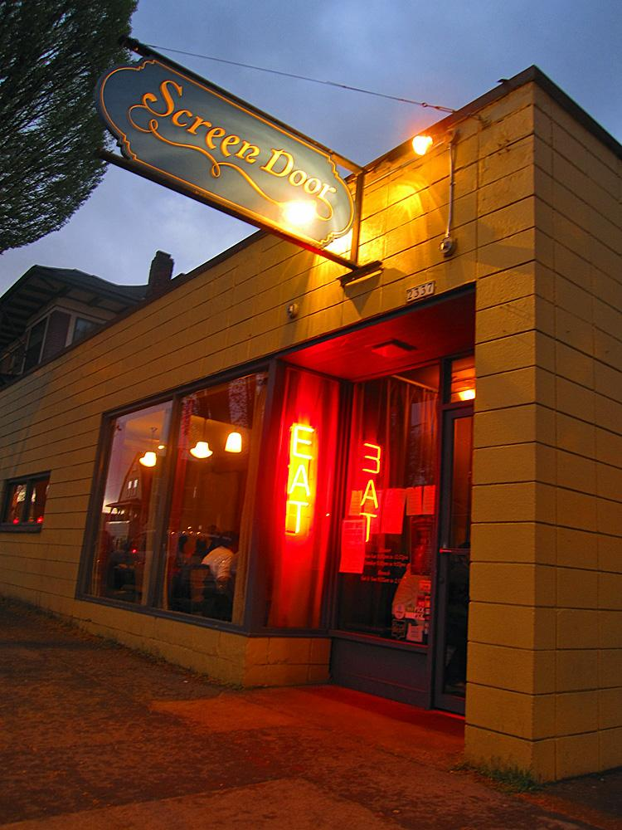
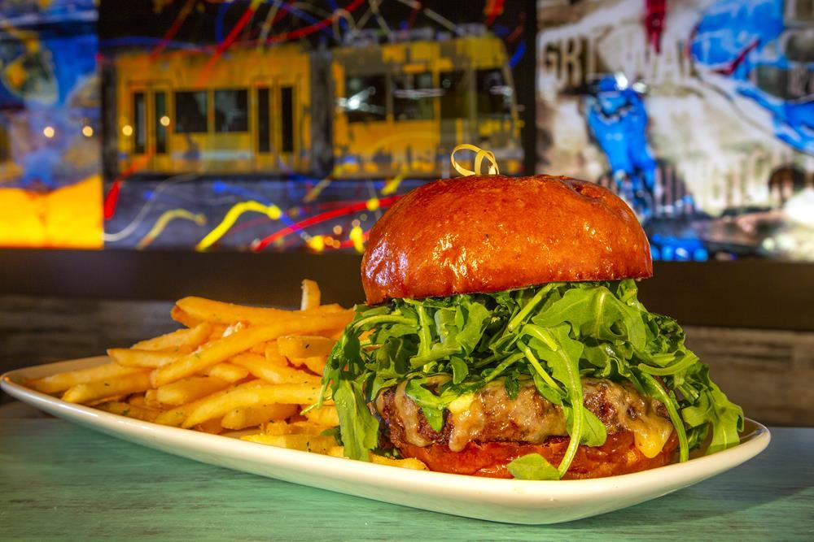
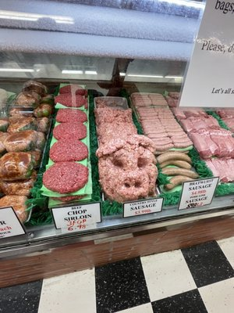
Collaborative-Filtering Recommendation
Case Study: Screen Door
1. Sharif's Coffee (Café) Correlation: 0.985287
Urban Steel Kitchen & Bar (Bars, , Restaurants, Cocktail Bar) Correlation: 0.978109
Original Steer Market (Specialty Food, Meat Shops, Food) Correlation: 0.956987
Most # of Yelp Reviews
Caterers, Restaurants, Breakfast & Brunch, Coffee & Tea

Slide 17

Content-Based Recommendation
Content-Based Recommendation recommends restaurants based on similar categories and keywords.
“Shake Shack’s burger was delicious!
Very tasty!
Steps:
1. Topic Modeling
2. CountVectorizer
“Five Guy’s fries were amazing!
3. Cosine Similarity

Slide 18
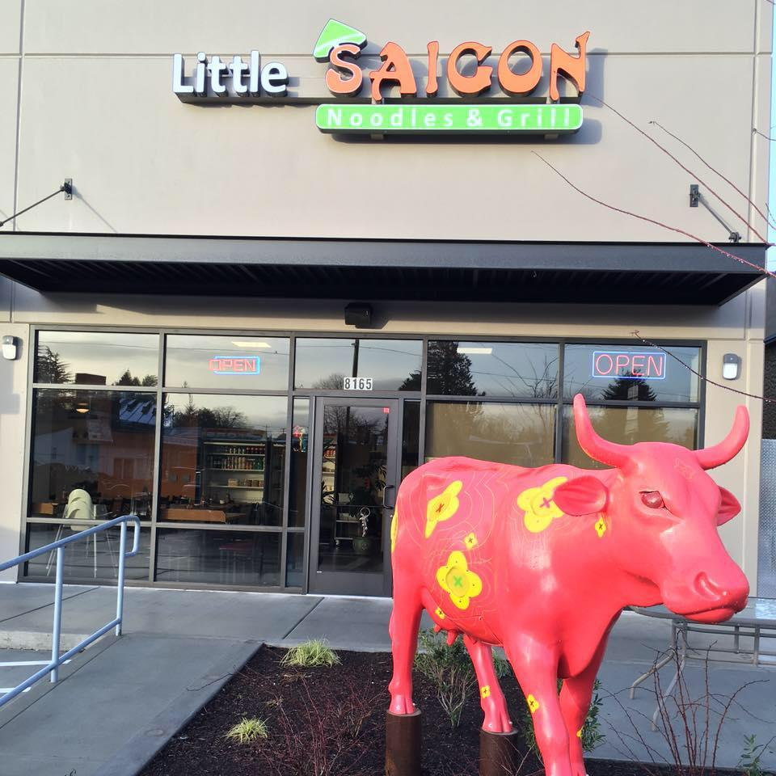
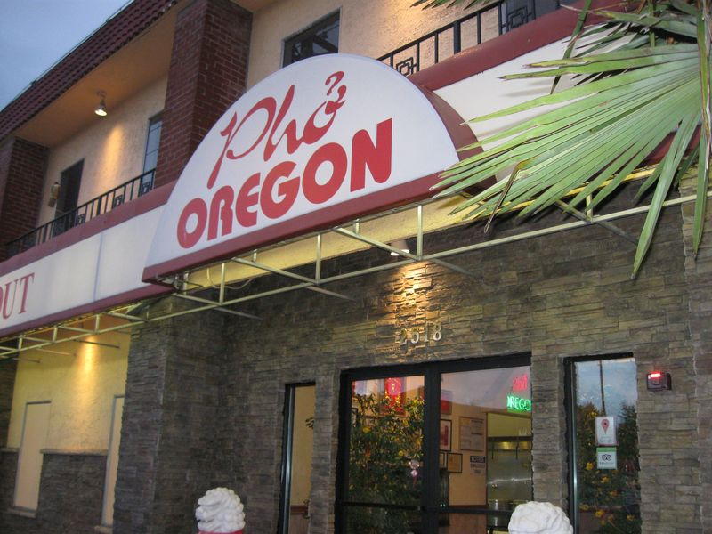
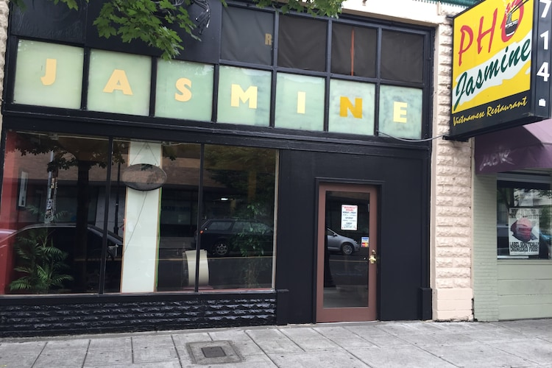
Content-Based Recommendation
Case Study: Pho Oregon Restaurant
1. Little Saigon Noodles & Grill
2. Pho Jasmine Restaurant
Vietnamese Cuisine
Keywords: Vietnamese, restaurants, noodle, great, place, food, …

Slide 19
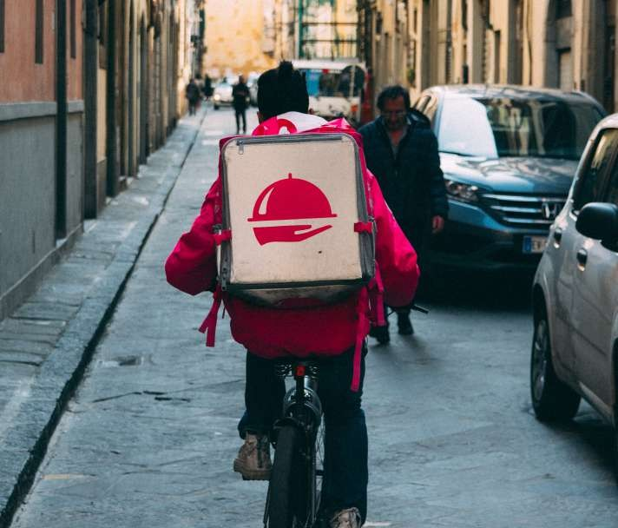
Limitations and Looking Forward
Detect user location.
Improve the program run better.
More restaurants will be updated, and the system will spread to many nations.
Allow users to comment and rate restaurant reviews then the restaurant's information is kept up to date.
A mobile platform can be used to implement the restaurant suggestion system.

Slide 20


Demo

Slide 21

Thanks!

